Slide 1
Introduction of OWASP(Open Web Application Security Project) Top 10
Guided by : Abhijeet Das
Presented by : Suryadev Chaudhay

Slide 2

Agenda
What is OWASP.
What is OWASP Top 10.
OWASP Top 10. Overview & What’s new.
List of OWASP tools

Slide 3
What is OWASP
OWASP : Open Web Application Security Project
Non-Profit Organization
Aim : Improve security in software development
Work : Reduce risk and vulnerability

Slide 4
What is OWASP Top 10
Most successful OWASP Project
Ten most critical web application security flaws
De facto Application security standard
Release every 3-4 year
First release 2004
Current 2021

Slide 5
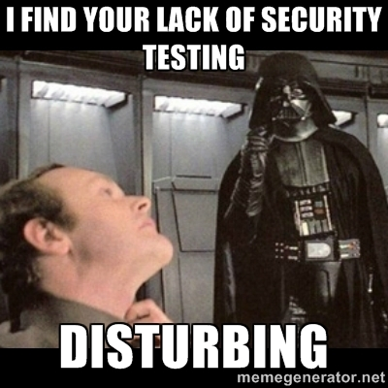

Slide 6
List of OWASP Top 10 - 2021
01 Broken Access Control
02 Cryptographic Failure
03 Injection
04 Insecure Design
05 Security and misconfiguration
06 Vulnerable and outdated component
07 Identification and Authentication failure
08 Software and Data integrity failure
09 Security logging and monitoring failure
10 Server side request forgery

Slide 7
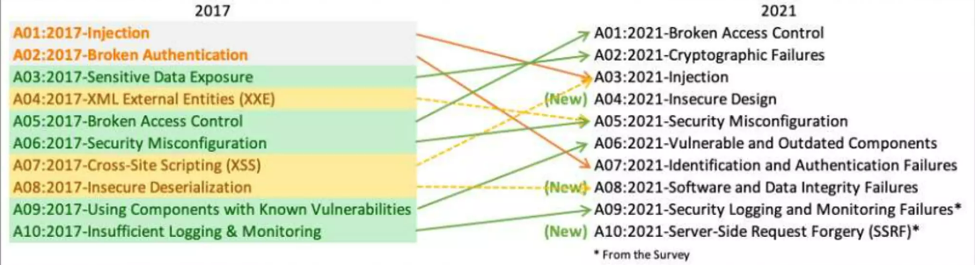

http://fr.slideshare.net/StephendeVries2/continuous-security-testing-with-devops
Agile/continuous development process can be interrupted during a sprint by security testing !

Slide 8
01 Broken Access Control
Move up from fifth position
Elevation of privelege
- Acting as Admin when logged in as a user
- Acting as a user without being logged in
Viewing or editing someone else’s account
Your account used by another user
Non-user can accessed my site
Cross-Origin Resource sharing (CORS) misconfiguration
- Allow API access from third party applications

Slide 9

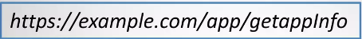
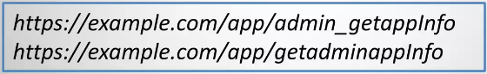
Example
Application provide the service on :
Attacker brouse the target URLs :

Slide 10
Prevent
Default behaviour : Deny access to resources
Except for public resources
Impeliment strong access control mechanism
On the server side
All request
Minimise CORS usage

Slide 11
02 Cryptographic failure
Use third party tool for data encryption that provided by hacker
Sensitive data is transmitted or stored in clear text
Use weak cryptographic algorithms use
Default crypto keys in use

Slide 12
Prevent
Encrypt all sensitive data
Don’t use lagecy protocol to transfer data
Don’t use encryption method provided by third party application
Use proper key management

Slide 13
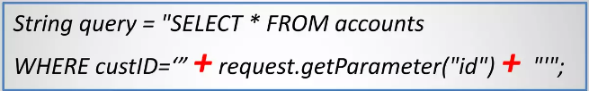
03 Injection
Slide down from first position
- was the first one since OWASP top ten – 2010
User input is not validated, filtered or sanitized by the application
User input is directly unwanted commands
- SQL Injection
- OS Command Injection
Ex : User input is directly used in the SQL call

Slide 14
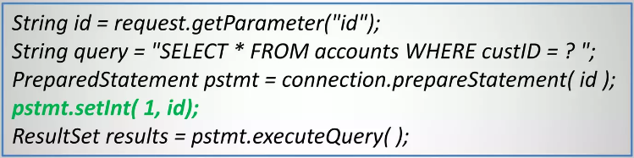
Prevent
Don’t pass user input directly to executable statement
Prepared statements
-Parameterized queries
-Hibernate
Ex : Use prepared statement :

Slide 15
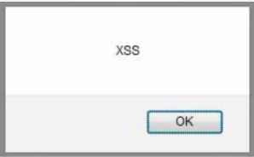
Don’t forget about XSS
Attackers can execute script in a victim’s browser
Prevent :
Input validation for user input
- Whitelist patterns
Encode output

Slide 16
SQL Injection
Vulnerable Usage
String newName = request.getParameter("newName");
String id = request.getParameter("id");
String query = " UPDATE EMPLOYEES SET NAME="+ newName + " WHERE ID ="+ id;
Statement stmt = connection.createStatement();
Secure Usage
//SQL
PreparedStatement pstmt = con.prepareStatement("UPDATE EMPLOYEES SET NAME = ? WHERE ID = ?");
pstmt.setString(1, newName);
pstmt.setString(2, id);
//HQL
Query safeHQLQuery = session.createQuery("from Employees where id=:empId");
safeHQLQuery.setParameter("empId", id);

Slide 17
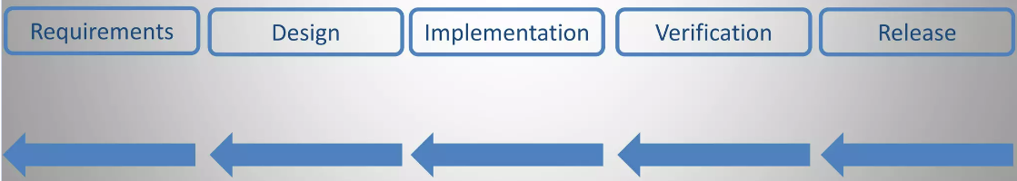
04 Insecure design
New in list
Pussing “shift-left” apporoach
- A secure design have insecure implementation
- An insecure design can’t be fixed by an implementation

Slide 18
How to fix it
Threat modeling
Threat modeling manifesto
https://www.threatmodelingmanifesto.org
Secure Development lifecycle(SDL)
https://wltimatesecurity.pro/post/sdl-meetup/

Slide 19
05 Security Misconfiguration
Missing security hardening
Unnecessary features are enabled or installed
- Unnecessary ports
- Services
- Accounts
Default accounts
Default passwords

Slide 20
Prevent
Apply security haedening
- CIS Benchmark
https://www.cisecurity.org/cis-benchmark/
Close unnecessary ports
Disable unnecessary services
Remove Default account
Change default passwords
Give proper guideline to client that ‘how to use’

Slide 21
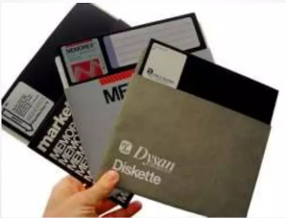
06 Vulnerable and outdated component
Software is vulnerable, Unsupported or out of date
- Apache Log4j (Log4shell), Vulnerabilities

Slide 22
Prevent
Update software periodically
Use Software Composition Analysis(SCA) tools
- Free commercial tools
- OWASP Dependency-Check
https://owasp.org/www-project-dependency-check

Slide 23
07 Identification and authentication failure
Slide down from the 2nd position
Previously known as ‘Broken Authentication
Missing multi-factor authentication
Missing bruit-force protection
Reusing session identifier after successful login
Exploring session identifier in the URL
https://salesdemo4.successfactors.com/login?company=abc123&username=cgrant&password=mypwd1
Using default, weak, or well known passwords
Password1, Name@123, 1234, Admin

Slide 24
How to prevent
Implement bruit force attack
Implement multi-factor authentication
Change default credentials
Implement password complexity(strong)
Rotate session IDs after successful login
Limited failure login attempt

Slide 25
08 Software and data integrity failure
New in list
Use component provided by third party
Upgrade without authentication
Use code or program provided by hacker

Slide 26
Prevent
Use Digital signature to verify software
Update from known sources
Review plan for code/configuration changes

Slide 27

09 Security logging and monitoring failure
Insufficient logging
- logins
-Failed logins
- High-value transaction
Not created log file
Not monitoring log file
Logs are only store locally

Slide 28
Prevent
Create backup of logs & important files
Create proper log files
Transaction
User id
Password
Client IP
Time

Slide 29
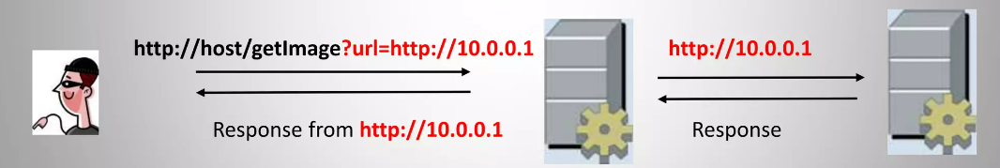
10 Server side request Forgery(SSRF)
New in list
Server give response on bad request
A web application fetching a remote resource without validating the user-supplied URL

Slide 30
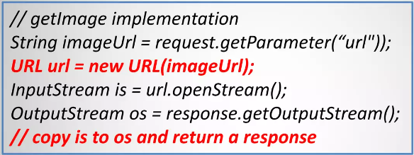
Example
Application provides the getImage service :

Slide 31
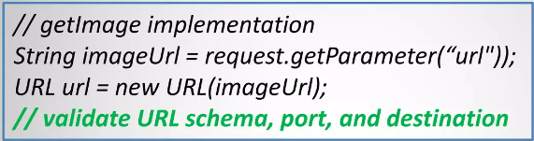
Prevent
Sanitize and validate all client-supplied input data
Validate URL Components
URL schema, Port & destination
Do not raw responses to client
Ex : Validate URL components

Slide 32
List of OWASP tools
01 OWTF (OWASP Offensive Web Testing Framework):
Use: A toolkit that combines various security tools for penetration testing and vulnerability assessment.
02 ZAP (OWASP Zed Attack Proxy):
Use: A widely-used web application security scanner for finding vulnerabilities in web applications during development and testing.
03 Dependency-Check:
Use: Identifies project dependencies and checks if there are any known, publicly disclosed, vulnerabilities.
04 Security Knowledge Framework (SKF):
Use: A guide to build your own Application Security Training Program or to create awareness on the topic.
05 WebGoat:
Use: A deliberately insecure web application designed to teach web application security lessons.
06 AppSensor:
Use: A framework for application layer monitoring, intrusion detection, and automated response.
07 OWASP CSRFGuard:
Use: Helps developers integrate CSRF protection into Java web applications.

Slide 33
08 OWASP Defectdojo:
Use: An open-source application vulnerability management tool built for DevOps and continuous security integration.
09 OWASP Glue Tool Project:
Use: A framework developed to integrate security tools into the SDLC.
10 OWASP Security Knowledge Framework - PHP (SKF PHP):
Use: PHP version of the Security Knowledge Framework, offering guidance on security best practices.
11 OWASP Security Shepherd:
Use: A web and mobile application security training platform.
12 OWASP Seraphimdroid:
Use: Mobile app security testing framework for Android.
13 OWASP Web Security Testing Guide (WSTG):
Use: Comprehensive guide for testing the security of web applications and web services.
14 OWASP Amass:
Use: A tool to help information security professionals perform network mapping of attack surfaces and external asset discovery.
15 OWASP OWTF: Offensive Web Testing Framework:
Use: A project focused on penetration testing efficiency and alignment of security tests to security standards like OWASP Testing Guide (v 4.0).

Slide 34

THANK YOU

Slide 35

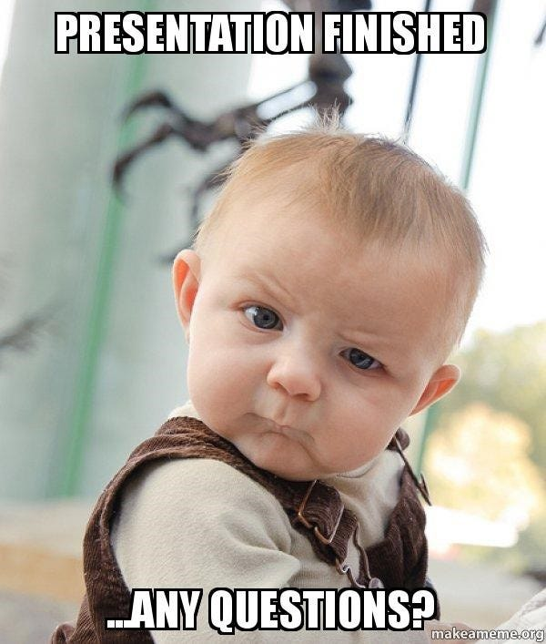
Contact me:
Email : Saigalsainy318333@gmail.com
GitHub : https://github.com/chaudharysurya14 LinkedIn : https://www.linkedin.com/in/scydevops/

